Slide 1




SDG GOAL 3: GOOD HEALTH AND WELLBEING
UNDER-5 CHILD MORTALITY RATE IN SELECTED AFRICAN COUNTRIES
BY
GROUP 4: WONDER WOMEN
POWERBI Dashboard

Slide 2
OUTLINE
1
INTRODUCTION
4
CONCLUSION
2
OBJECTIVE
5
RECOMMENDATION
3
DASHBOARD

Slide 3
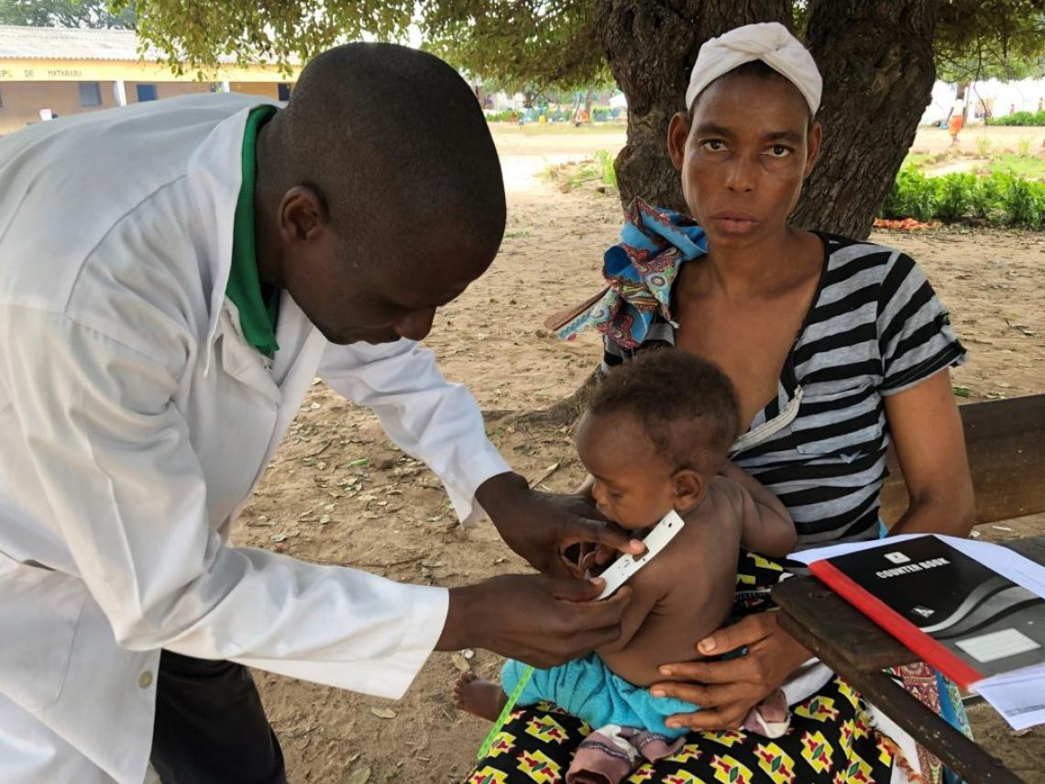
INTRODUCTION
According to the Sustainable Development Goal (SDG) set in 2015 by the United Nations, countries are encouraged to meet a child mortality rate of 25 deaths per 1000 live birth by 2030.
In this project, we shall estimate the levels and trends of some selected African countries from 2009 to 2019 and forecast the Child Mortality rate for 2020 - 2025 to access the country’s progress and the tendency to achieve the set (SDG) goal on child survival.

Slide 4
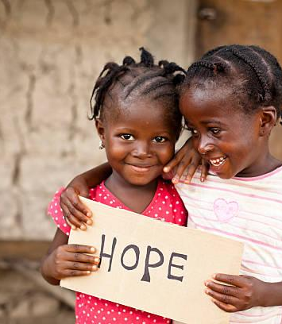
OBJECTIVE
To describe the prevalence of under-5 child mortality rate in the selected African countries
To analyze and identify possible causes of high under-5 mortality rates in the selected African countries
To forecast the possible trend of under-5 mortality rate in the selected African countries from 2020-2025
To recommend possible solutions for mitigating the under-5 mortality rate in the selected African countries.

Slide 5
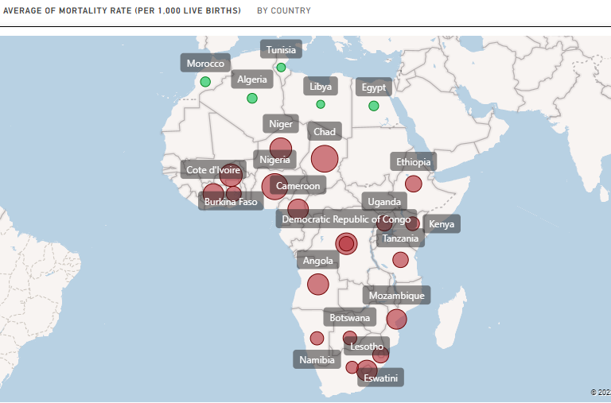
DASHBOARD
Map showing the average Mortality Rate in Africa.
Countries in Green have achieved the SDG target while those in Red have not
The dashboards below shows the visual for each Region in Africa

Slide 6
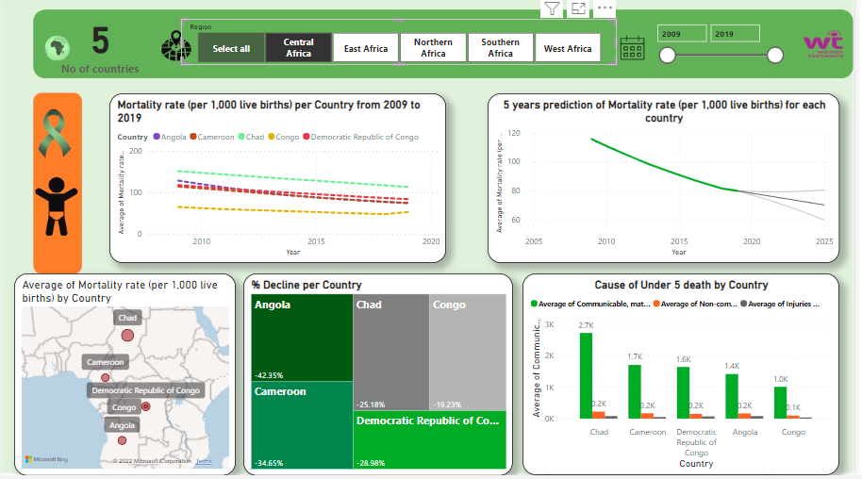
CENTRAL AFRICA

Slide 7
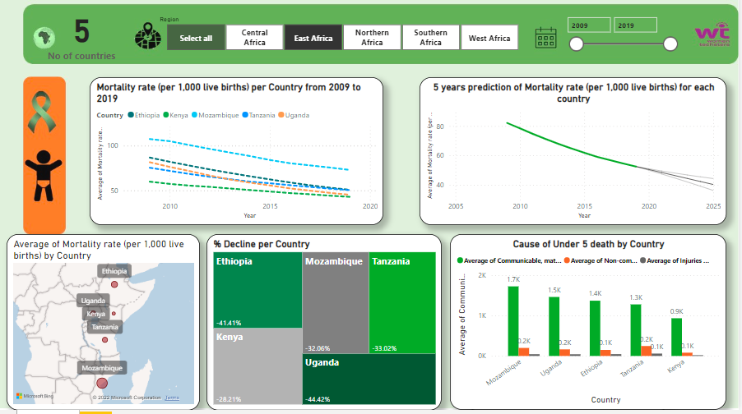
EAST AFRICA

Slide 8
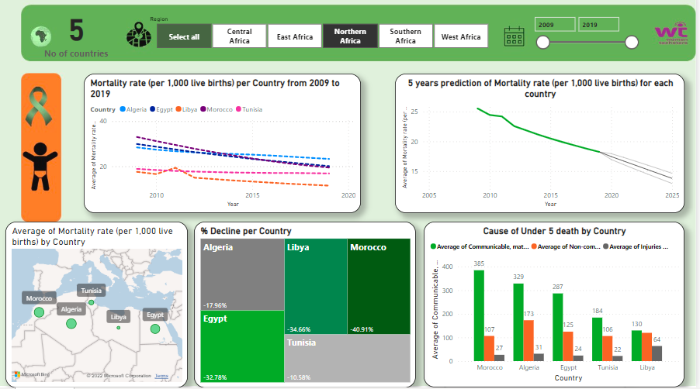
NOTHERN AFRICA
RESEARCH FINDINGS

Slide 9
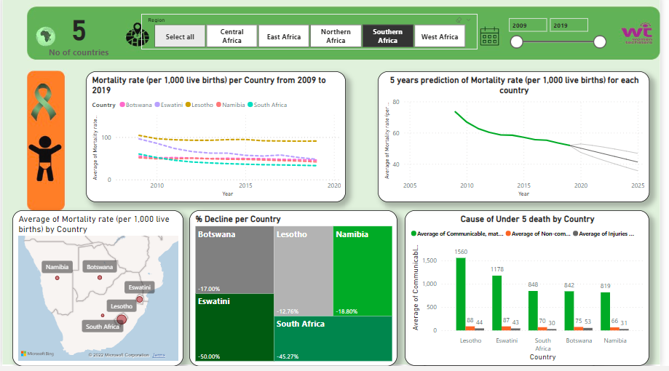
SOUTHERN AFRICA

Slide 10
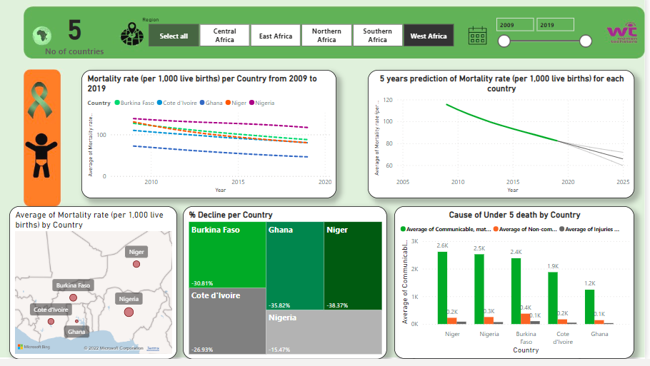
WEST AFRICA

Slide 11
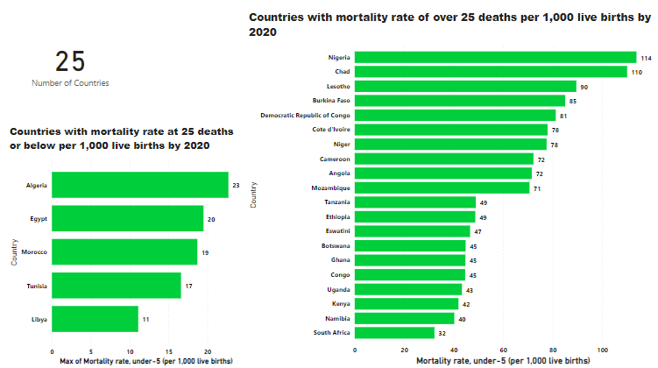

Slide 12
CONCLUSION
Communicable diseases such as measles, and nutritional-related diseases are the most prevalent causes of under-5 mortality in the selected African countries.
Nigeria has the highest rate of under-5 mortality rate with 119.90 death per 1000 live birth in 2019, while Libya has the lowest with 11-50 death per 1000 live birth in 2019.
All the selected Northern African countries have been able to achieve the set goal of reducing the child mortality rate to 25 deaths per 1000 live birth.
The prediction shows that none of the West, Central, or East African countries has the tendency to achieve a child mortality rate reduction of 25 deaths per 1000 live birth by 2025. Although, Eswatini in Southern Africa has the tendency to achieve this goal by 2025.

Slide 13
RECOMMENDATION
Intensify sensitization and programs on Water, Sanitation, and Hygiene (WASH) in rural communities.
Increase availability of medical personnel and Health care facilities
Implementing policies against early marriage, child labour, and child abuse.
Vaccination
Research on the treatment of communicable (measles) and non-communicable diseases (malaria)

Slide 14
DATA SOURCES
Our World in Data (2020) – Child Mortality Around the World. Ourworldindata.com. Retrieved 10th October 2022 from https://drive.google.com/drive/folders/15hJJa6ID3BGmpJ7nCDUrg_OMSFCCme8s?usp=sharing
Our World in data (2020) – Breakdown of Child Mortality by cause. Ourworldindata.com. Retrieved October 10, 2022 from https://ourworldindata.org/grapher/breakdown-of-child-mortality-by-cause?country=~DZA
Medical Xpress (2019) – Measles Outbreak in Congo. Medicalxpress.com. Retrieved October 15, 2022 from https://medicalxpress.com/news/2019-10-measles-outbreak-congo-year.html
United Nations - Ensure healthy lives and promote well-being for all at all ages. Sdgs.un.org. Retrieved October 10, 2020 from https://sdgs.un.org/goals/goal3

Slide 15


Slide 16

ANY
QUESTIONS?

Slide 17
ACTIVE MEMBERS
OLUWABUKOLA AREMO
ELIZABETH UCHECHI M. MMADUKA
IFUNANYA NICHOLAS
INTISAR HAMZA SULEIMAN
ONYINYE MICHELLE NWAFOR
OKENWA AMARA
OKWU OGECHUKWU SYLVIA
OLADIPUPO OLUMAYOWA
NNOKE-UKA CHIDINMA
YAHAYA JEMILAT
DAMILOLA ELIZABETH OLOFIN

